Slide 1
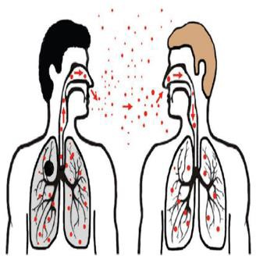
Chapter 10 Pathogens and Immunity
Pathogens are agents/microorganisms that cause disease.
Examples
Pathogen | Disease
Virus | Influenza, common cold, AIDS …
Bacteria | Cholera, tuberculosis
Protoctists | Malaria
Fungi | Athlete’s foot
Ways in which pathogens enter the body Direct Contact
Transmission is the passing of pathogen to an uninfected person.
Infection is the entry of the pathogen into the body.
Transmissible disease is a disease in which the pathogen can pass from one host to another.
Some pathogens pass from an infected person to an uninfected one when there is direct contact between them. Diseases transmitted like this is known as contagious disease.
Indirect transmission Through respiratory Passages
Diseases transmitted through respiratory passages
such as common cold and influenza.
The virus is carried in the air in tiny water droplets. The infected person propels into the air water

Slide 2
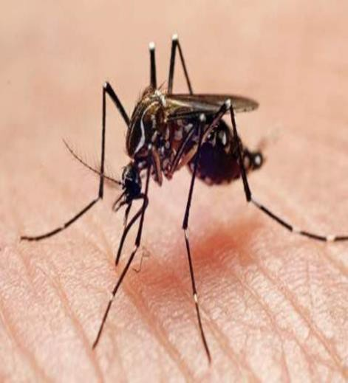
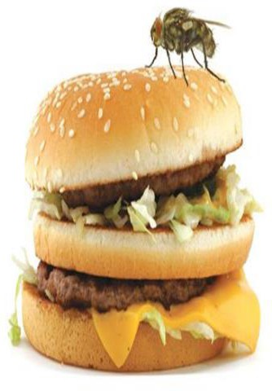
droplets when he or she speaks, coughs or sneezes. These droplets are inhaled by a healthy person.
By vector
A vector acts as a carrier of the pathogen from one host to another.
Anopheles mosquitoes are the vectors for malaria. The female mosquito may have the protoctist pathogen plasmodium in their saliva, which they inject in the blood of a healthy person when they bite.
Through contaminated food or water
Contaminated food or water with faeces from an infected person can cause cholera.
Salmonella poisoning caused by bacteria when enter the alimentary canal with contaminated food we eat.
Body defenses
The human body has many physical and chemical barriers that are always ready to defend the body against any harmful microorganisms that could cause it any illness.
1) Mechanical Barriers A) The skin
The skin has a thick outer layer of dead cells, containing a protein called keratin, that is very difficult to penetrate.

Slide 3
The nose
The nasal cavity contains hairs that trap dust that might be carrying pathogens
Cilia
These are microscopic hairs that flick to sweep the mucus back up to the throat, where it can be swallowed.
Chemical Barriers
Hydrochloric acid
In the stomach, hydrochloric acid kills many of the bacteria in the food we eat, as well as those swallowed in mucus.
Mucus
Goblet cells in the alimentary canal and in the respiratory system produce sticky mucus. Mucus traps pathogens.
Food Hygiene
Keep your hair out of food.
Never cough or sneeze over food.
Always wash your hands before touching or eating food or putting your hand into your mouth for any reason.
Do not keep food at room temperature for long periods. Keeping food in the fridge will slow down bacterial growth. Cooking food at high temperature will kill bacteria.
Keep raw meat away from other food. Raw meat often contains bacteria. This is not a problem if the meat is to be cooked, as the bacteria will be killed.
Keep animals away from food.

Slide 4
Personal Hygiene
Personal hygiene means keeping your body clean.
Wash your face regularly.
Keep your nails clean.
Brush your teeth frequently.
Wash your body as often as possible.
If oil, dirt and sweat are left on the skin for long, they provide breeding media for bacteria
Waste disposal
Waste disposal is all the activities and actions required to manage waste from its inception to its final disposal.
Landfill site is a site for the disposal of waste materials by burial.
When the site is full, it can be covered over with soil and grass and trees are allowed to grow.
Treatment
The rubbish is rotted by decomposers.
Methane gas is produced.
Pipes are placed in the rubbish to allow the methane to escape harmlessly into the air or can be collected used as a fuel.
Sewage treatment
Sewage treatment is the process of removing contaminants from wastewater, primarily from household sewage.
It is based on removal of sewage sludge and killing the pathogens.

Slide 5
Cholera:
Is a disease caused by a bacterium transmitted through contaminated food or drink
Cholera disease causes watery feces or sever diarrhea and vomiting which can lead to dehydration.
What causes the patient to have watery feces?
Vibrio choler bacterium produces a toxin in the small intestines
The toxin binds to intestinal cells
It causes the cells to reduce absorption of sodium ions and increase the secretion of chloride ions into the intestines.
By osmosis, water passes out of the cells into the small intestines.
This causes severe diarrhea that results indehydration and loss of ions from the blood
Treatment of cholera
Patients should drink water containing sugar and ions to replace the lost water by feces
Severely dehydrated patients may need intravenous fluid
Antibiotics to kill the bacteria

Slide 6
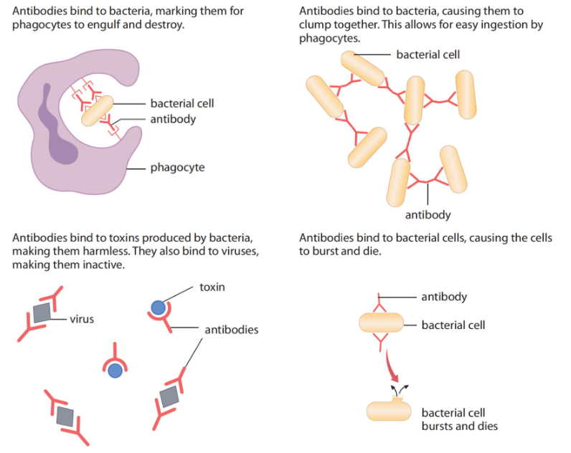
The immune system
Our immune system is a network of cells, tissues, proteins, and organs that work together to defend the body against attacks by 'foreign' invaders.
White blood cells - Lymphocytes
When lymphocytes recognize a pathogen, start to divide rapidly by mitosis, making a clone of lymphocytes just like itself.
These lymphocytes then secrete their antibodies, destroying the pathogen.
Antibodies
They are large Y-shaped proteins which function to identify and help remove foreign antigens or targets such as viruses and bacteria. Every different antibody recognizes a specific foreign antigen.
Sorting antibodies according to their function

Slide 7
Why do we get sick when we catch a new infection?
It takes time (few days):
For lymphocytes to recognize the pathogen.
To produce a big enough clone by mitosis.
To make enough antibodies.
As a result, the pathogen has a chance to breed and make you ill.
Memory cells
They are a long-lived type of white blood cells that can respond quickly when it meets a pathogen for the second time. They produce the right antibody for the particular pathogen and destroy it before you feel unwell.
Vaccination
Vaccination involves exposing the body's immune system to a weakened or harmless version of the pathogen in order to stimulate white blood cells to produce antibodies.
Vaccines may contain:
Live pathogens that are treated to make them harmless.
Harmless fragments of pathogens.
Treated Toxins produced by pathogens.
Dead pathogens.

Slide 8
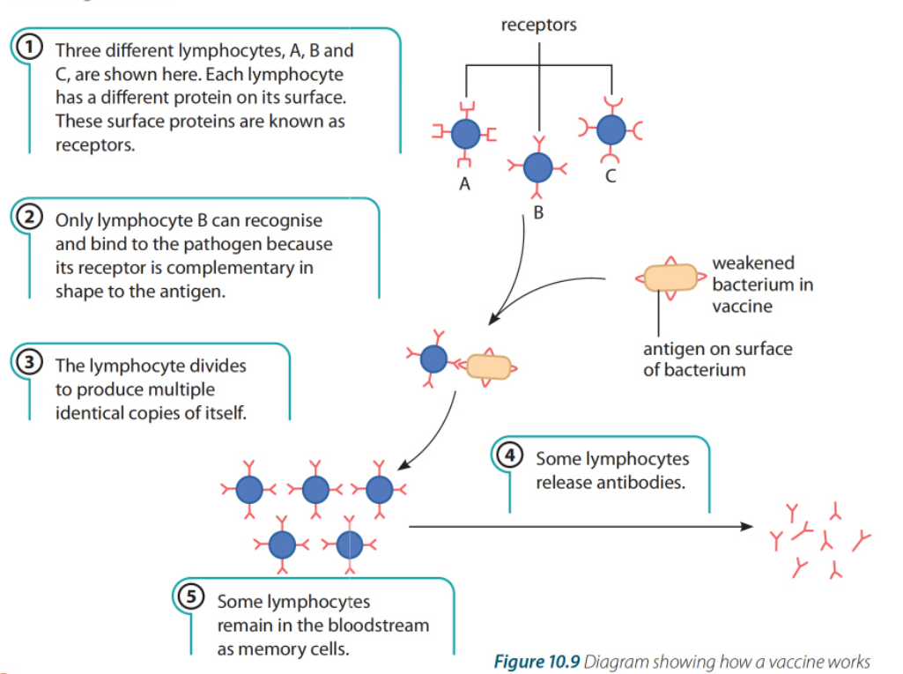
How vaccination works?

Slide 9
Immunity
Active immunity
Immunity in an organism resulting from its own production of antibodies and memory cells.
Passive immunity
Immunity resulting from the getting antibodies from another organism.
Active Immunity
Natural active immunity
A natural cause of active immunity is when you get an infection for the first time.
Artificial active immunity
An artificial cause is when you are injected with weakened pathogens.
Passive Immunity
Natural passive immunity
The natural cause of passive immunity is the introduction of antibodies from another person, breast feeding or through the placenta to the fetus.
Artificial passive immunity
The artificial cause of passive immunity is when high levels of antibodies that are specific to a pathogen or toxin are injected into a non-immune person through their blood.

Slide 10
Active immunity | Passive immunity
Antibody production by our lymphocytes in the body. | Antibodies are acquired from another individual.
Production of memory cells. | No production of memory cells.
Provide long – term immunity | Provide short – term immunity.
Controlling disease by vaccination Small pox
Caused by a virus;
Transmitted by direct contact;
Often leave scars on the skin and may cause blindness;
May kill.
The world health organization (WHO) vaccinated 80% of people in the world who were at risk of getting the disease.
The campaign was a success and eradicated smallpox.
Measles
Caused by a virus;
Spread by airborne droplets;
It causes a skin rash and fever, and sometimes it causes blindness and brain damage.
Eradication of measles still not possible because it needs at least 93% of the children to be vaccinated.
If parents decided not to have their children vaccinated, then outbreaks of measles can still occur.

Slide 11
Auto-immune diseases
They are incurable but controllable diseases that result from the malfunction of the immune system. The immune system (lymphocytes) decides that your healthy cells as foreign and as a result, it attacks healthy cells.
Normally, our lymphocytes recognize our own cells as “self”, and do not produce
antibodies against them.
TYPE (1) DIABETES as an example of auto-immune disease
Antibodies &immune cells attack(beta-cells) in pancreas that produce insulin hormone
Beta cells are damaged, no more production of insulin which results in the un-control of blood glucose (high glucose level in blood).
Treatment
Patients have to take insulin at regular intervals.
Patients have to take great care over what they eat (avoid eating sugar/carbohydrates.

Slide 12
Antibiotics
A drug: is any chemical substance that can affect or modify chemical reactions in the body.
Antibiotic: are drugs that are used to treat bacterial and some fungal infections.
How Antibiotics work?
1- Inhibit synthesis of bacterial cell wall
2-Inhibits protein synthesis
3- Inhibits enzyme action
4- Inhibits cell membrane
Why Antibiotics kill bacteria but NOT viruses?
Antibiotics act on bacterial cell walls, break up bacterial cell membrane or inhibit protein synthesis and growth of bacteria. Viruses do not have cell walls, cell membrane s or ribosomes.
Why full course antibiotic should be completed by patients?
Feeling better in symptoms does not mean that the infection is completely treated.
Some bacteria may still there( unable to cause harm) but still able to mutate and become antibiotic resisting bacteria

